Slide 1
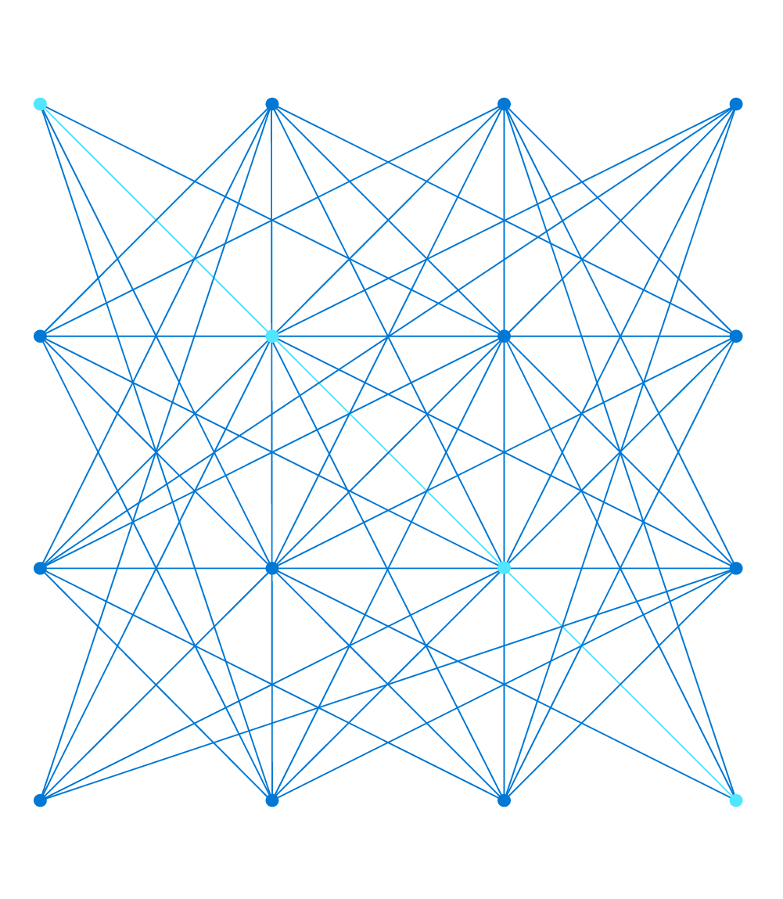
AZ-303: Microsoft Azure Architect Technologies

Slide 2
Module 6: Implement Storage Accounts
Azure Blog Storage, Storage Security, and Azure Storage Firewalls

Slide 3

Learning Objectives
You will learn the following concepts:
Storage Accounts
Blob Storage
Storage Security
Accessing Blobs and Queues using AAD
Managing Storage
Configure Azure Storage Firewalls and Virtual Networks
Managing Storage

Slide 4
Storage Accounts

Slide 5

Azure Storage
Azure storage is:
Durable and highly available
Secure
Scalable
Managed
Accessible
Three categories of Azure storage
Storage for virtual machines
Unstructured data
Structured data
General purpose storage accounts have two tiers
Standard
Premium

Slide 6
Azure Storage Services
Azure Containers (blobs)
Accessible from anywhere via HTTP or HTTPS
Stores massive amounts of unstructured data, such as text or binary
Azure Files
Accessible from anywhere via SMB 3.0
Hosts highly available network file shares
Azure Queues
Accessible from anywhere via HTTP or HTTPS Provides a queue-based mechanism for asynchronous communication
Stores messages of up to 64 KB in size in queues
Azure Tables
Accessible from anywhere via HTTP or HTTPS
Stores NoSQL tables

Slide 7




Azure Storage Account Types (1 of 2)
A storage account is a container that groups a set of Azure Storage services together. Only data services from Azure Storage can be included in a storage account.
Azure storage accounts:
Azure storage services:
General-purpose v1/v2
Blob, File, Queue, Table, and Disk
Azure Containers (Blobs): A massively scalable object store for text and binary data.
Azure Files: Managed file shares for cloud or on-premises deployments.
File-storage accounts
Files only
Azure Queues: A messaging store for reliable messaging between application components.
Blob-storage accounts (and BlockBlob)
Block blobs and append blobs only
Azure Tables: A NoSQL store for schemaless storage of structured data.
Notes:
Azure provides many ways to store your data. There are multiple database options like Azure SQL Server, Azure Cosmos DB, and Azure Table Storage. Azure offers multiple ways to store and send messages, such as Azure Queues and Event Hubs. You can even store loose files using services like Azure Files and Azure Blobs.
The Azure Storage Services illustration: Azure selected the four services, Azure Blobs, Azure Files, Azure Queues, and Azure Tables, and placed them together under the name Azure Storage.
These four services were given special treatment because they are all primitive, cloud-based storage services and are often used together in the same application.
Azure Storage compared to AWS Storage
Azure creates storage accounts for primitive types of storage. General Purpose storage Accounts allow use of all of the “primitives” (Blob, File, Queue, Table, and Disk). Storage Account types are blob only, files only or allow all storage account services for general purpose Azure Storage Accounts.

Slide 8
Azure Storage Account Types (2 of 2)
Storage account type | Supported services | Supported performance tiers | Replication options
BlobStorage | Blob (block blobs and append blobs only) | Standard | LRS, GRS, RA-GRS
General-purpose V1 | Blob, File, Queue, Table, and Disk | Standard, Premium | LRS, GRS, RA-GRS
General-purpose V2 | Blob, File, Queue, Table, and Disk | Standard, Premium | LRS, GRS, RA-GRS, ZRS, ZGRS (preview), RA-ZGRS (preview)
Block blob storage | Blob (block blobs and append blobs only) | Premium | LRS, ZRS (limited regions)​
FileStorage | Files only | Premium | LRS, ZRS (limited regions)​

Slide 9

Azure Storage Account Replication Features (1 of 5)
Data redundancy:
Locally redundant storage (LRS)
Zone-redundant storage (ZRS)
Geographically redundant storage (GRS)
Read-access geo-redundant storage (RA-GRS)
Geo-zone-redundant storage (GZRS)
Read-access geo-zone-redundant storage (RA-GZRS)

Slide 10
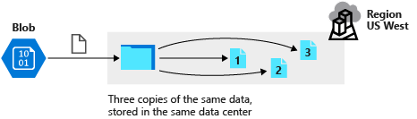
Azure Storage Account Replication Features (2 of 5)
What is locally redundant storage (LRS)?

Slide 11
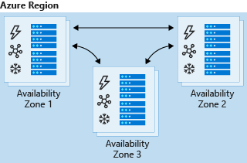
Azure Storage Account Replication Features (3 of 5)
What is zone-redundant storage (ZRS)?

Slide 12
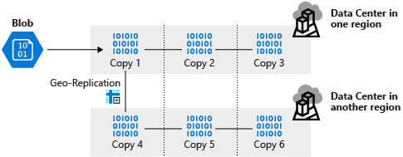
Azure Storage Account Replication Features (4 of 5)
What is geographically redundant storage (GRS)?

Slide 13
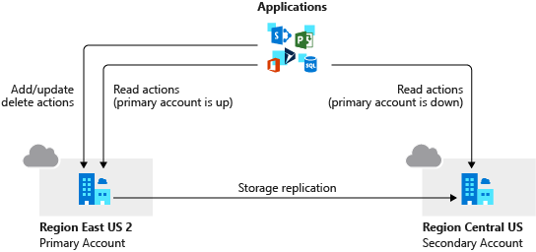
Azure Storage Account Replication Features (5 of 5)
What is read-access geo-redundant redundant storage (RA-GRS)?

Slide 14

Accessing Storage
Every object that you store in Azure Storage has a unique URL address:
Container service: https://mystorageaccount.blob.core.windows.net
Table service: https://mystorageaccount.table.core.windows.net
Queue service: https://mystorageaccount.queue.core.windows.net
File service: https://mystorageaccount.file.core.windows.net
There are two ways to configure a custom domain for accessing blob storage:
Direct CNAME mapping
Intermediary mapping with asverify

Slide 15
Blob Storage

Slide 16
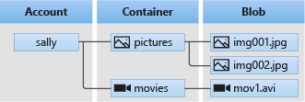

Blob Storage
Common uses of blob storage:
Serving images or documents directly to a browser
Storing files for distributed access, such as installation
Streaming video and audio
Storing data for backup and restore, disaster recovery, and archiving
Storing data for analysis by an on-premises or Azure-hosted service
Blob service includes three types of resources:
The storage account
Containers in the storage account
Blobs in a container

Slide 17
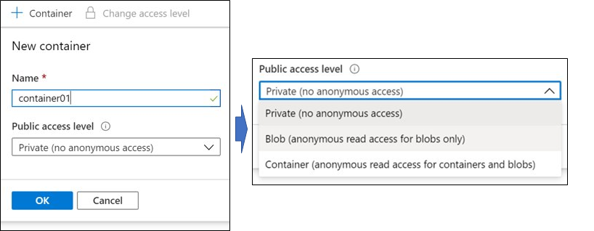
Blob Containers
To create a container, you specify:
Name
Public access level (private, blob, or container)

Slide 18
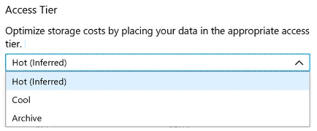
Blob Access Tiers
Hot: optimized for frequent access of objects in the storage account
Cool: optimized for storing large amounts of data that is infrequently accessed and stored for at least 30 days.
Archive: optimized for data that can tolerate several hours of retrieval latency and will remain in the Archive tier for at least 180 days

Slide 19
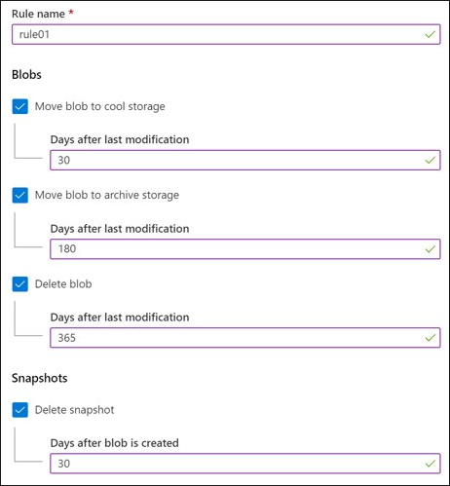
Blob Lifecycle Management
Blob lifecycle management policy lets you:
Transition blobs to a cooler storage tier (hot to cool, hot to archive, or cool to archive) to optimize for performance and cost
Delete blobs at the end of their lifecycles
Define rules to be run once per day at the storage account level
Apply rules to containers or a subset of blobs (using prefixes as filters).

Slide 20
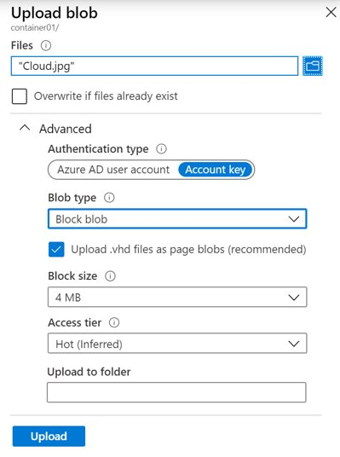
Uploading Blobs
Azure Storage supports three types of blobs:
Block blobs (default)
Append blobs
Page blobs
Blob upload tools include:
AzCopy
Azure Storage Data Movement Library
Azure Data Factory
Blobfuse
Azure Data Box Disk
Azure Import/Export

Slide 21
Storage Pricing
When using a storage account, the following billing considerations apply:
Performance tiers
Data access costs
Transaction costs
Geo-replication data transfer costs
Outbound data transfer costs
Changing the storage tier

Slide 22
Demonstration: Blob Storage
Create a container
Upload a block blob
Download a block blob

Slide 23
Storage Security

Slide 24

Storage Security
High-level security capabilities for Azure storage:
Encryption
Authentication
Data in transit
Disk encryption
Shared access signatures
Authorization options:
Azure Active Directory (Azure AD)
Shared key
Shared access signatures
Anonymous access to containers and blobs

Slide 25
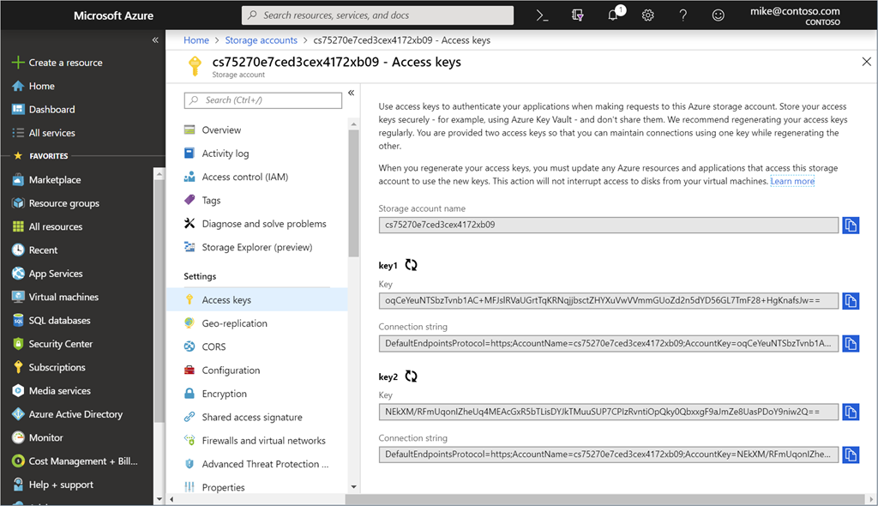
Storage Account Keys
Azure creates two keys (primary and secondary) for each storage account
Either of the keys provides full access to the account
You should regenerate keys on a regular basis or if they are compromised

Slide 26
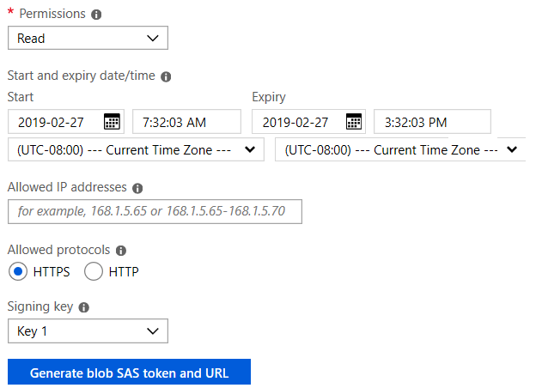
Shared Access Signatures
Shared access signatures (SAS) grant restricted access rights to Azure Storage resources
Access level can be very granular, including support for:
An account-level SAS to delegate access to multiple storage services
A time interval during which the SAS is valid
Object and container level permissions
IP address range from which Azure Storage will accept the SAS token
The protocol over which Azure Storage will accept the SAS token

Slide 27
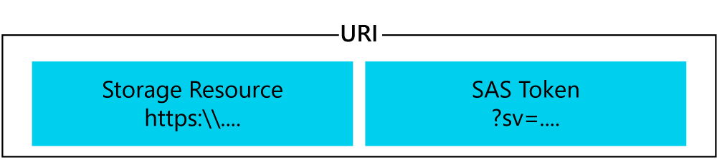
URI and SAS Parameters
A URI is created using parameters and tokens as you create your SAS
The URI consists of your Storage Resource URI and the SAS token
https://myaccount.blob.core.windows.net/?restype=service&comp=properties&sv=2015-04-05&ss=bf&srt=s&st=2015-04-29T22%3A18%3A26Z&se=2015-04-30T02%3A23%3A26Z&sr=b&sp=rw&sip=168.1.5.60-168.1.5.70&spr=https &sig=F%6GRVAZ5Cdj2Pw4txxxxx

Slide 28
Demonstration: SAS (Portal)
Create a SAS at the service level
Create a SAS at the account level

Slide 29
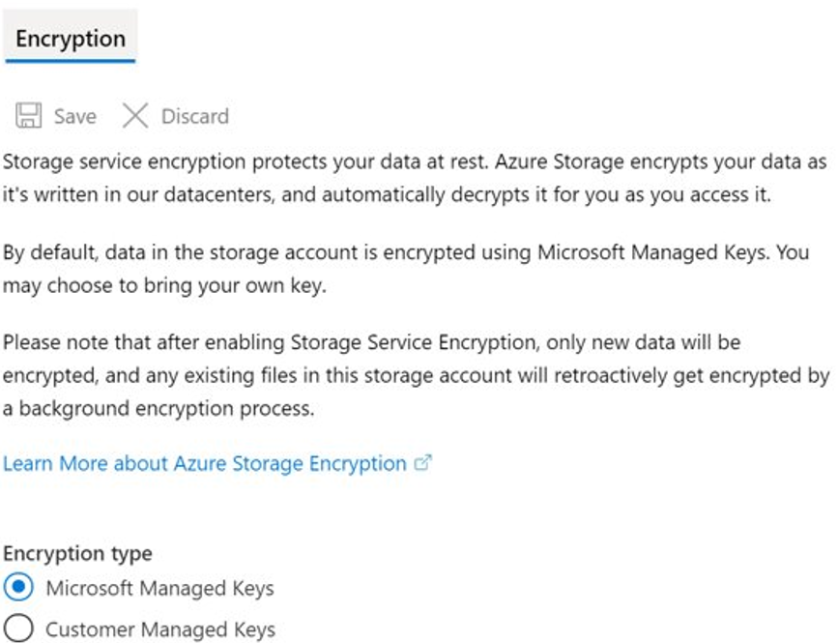
Storage Service Encryption (SSE)
Azure Storage Service Encryption (SSE) for data at rest helps protect data
SSE is enabled for all new and existing storage accounts and cannot be disabled

Slide 30
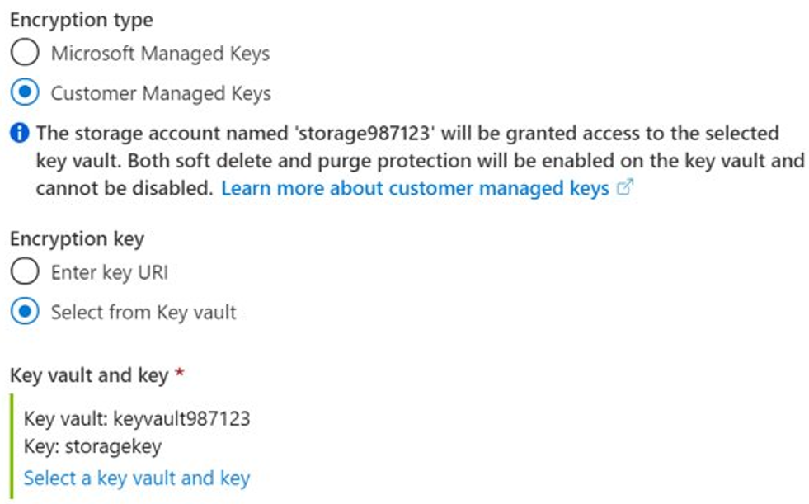
Customer Managed Keys
Use Azure Key Vault to generate and store encryption keys

Slide 31
Storage Security Best Practices
Risks:
If a SAS is compromised, it can be used by anyone who obtains it
If a SAS provided to a client application expires and the application is unable to retrieve a new SAS from your service, then the application's functionality may be hindered
Recommendations:
Always use HTTPS to create or distribute a SAS
Reference stored access policies where possible
Use near-term expiration dates on an ad hoc SAS
Have clients automatically renew the SAS
Be careful with SAS start time
Be specific with the resource to be accessed
Your account will be billed for any usage
Validate data written using SAS
Don’t assume SAS is the correct choice
Use Storage Analytics to monitor your application

Slide 32
Accessing Blobs and Queues using AAD

Slide 33
Authorize Access to Blobs and Queues using AAD
Azure Storage supports using Azure Active Directory (Azure AD) to authorize requests to Blob and Queue storage.
Authorizing requests against Azure Storage with Azure AD provides superior security.

Slide 34
Overview of Azure AD for Blobs and Queues
When a security principal attempts to access a blob or queue resource, the request must be authorized
The authentication step requires that an application request an OAuth 2.0 access token at runtime
The authorization step requires that one or more RBAC roles be assigned to the security principal

Slide 35
RBAC Roles for Access
Built-in RBAC roles for blobs and queues
Storage Blob Data Owner
Storage Blob Data Contributor
Storage Blob Data Reader
Storage Queue Data Contributor
Storage Queue Data Reader
Storage Queue Data Message Processor
Storage Queue Data Message Sender

Slide 36
Resource Scope
The levels at which you can scope access to Azure blob and queue resources:
An individual container
An individual queue
The storage account
The resource group
The subscription

Slide 37
Access Data with an Azure AD Account
Access to blob or queue data from the Azure portal is available based on either:
One of the storage account access keys (requires an RBAC role with Microsoft.Storage/storageAccounts/listkeys/ action permission)
An Azure AD account with permissions to access blob or queue data and to navigate through storage account resources

Slide 38
Configure Azure Storage Firewalls and Virtual Networks

Slide 39

Azure Storage Firewalls and Virtual Networks
Azure Storage Firewall and Virtual Networks protect storage at the network level.
Considerations:
Configure a rule to deny access from all networks and then grant access to traffic from specific virtual network subnets only.
If needed, configure rules to grant access to allow connections from specific internet or on-premises clients.
Network rules are enforced on all network protocols to Azure storage, including REST and SMB.
Once network rules are applied, they're enforced for all requests, including those based on SAS.
Virtual machine disk traffic is not affected by network rules.
Classic storage accounts do not support firewalls and virtual networks.

Slide 40
Change the Default Network Access Rule
Managing default network access rules
By default, storage accounts accept connections from clients on any network
To limit access to selected networks, you must first change the default action
Using the Azure portal
Use the Firewalls and virtual networks settings
Using Azure CLI
az storage account update --resource-group "myresourcegroup" --name "mystorageaccount" --default-action Deny
az storage account update --resource-group "myresourcegroup" --name "mystorageaccount" --default-action Allow

Slide 41
Grant Access from a Virtual Network
Consider available virtual network regions
Consider required permissions
Implement virtual network rules via the Azure portal:
Go to the storage account you want to secure
Click on the settings menu called Firewalls and virtual networks
Check that you've selected to allow access from Selected networks
To grant access to a virtual network with a new network rule, under Virtual networks, click Add existing virtual network, select Virtual networks and Subnets options, and then click Add
To create a new virtual network and grant it access, click Add new virtual network, provide the necessary information, then click Create

Slide 42
Grant Access from an Internet IP Range
Identify the relevant internet facing IP addresses.
Configure IP network rules:
Go to the storage account you want to secure
Click on the settings menu called Firewalls and virtual networks.
Check that you've selected to allow access from Selected networks
To grant access to an internet IP range, enter the IP address or address range (in CIDR format) under Firewall > Address Range
To remove an IP network rule, click the trash can icon next to the address range
Click Save to apply your changes

Slide 43
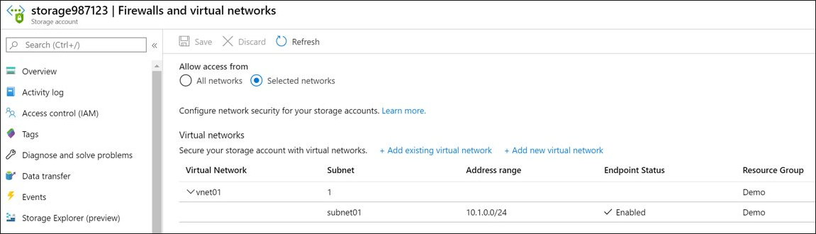
Securing Storage Endpoints
Firewalls and virtual networks settings allow restricting access to a storage account from specific virtual network subnets.
Virtual networks and their subnets must exist in the same Azure region or the region pair as the storage account.

Slide 44
Demonstration: Securing storage endpoints
Create a storage account
Upload a file
Secure the file endpoint

Slide 45
Managing Storage

Slide 46

Import and Export Service (1 of 2)
Usage cases:
Migrating data to the cloud
Content distribution
Backup
Data recovery

Slide 47
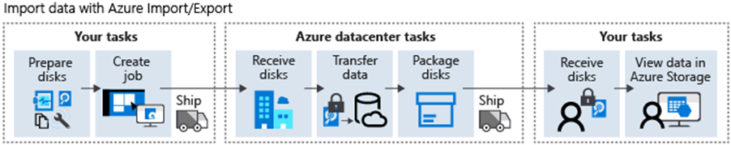
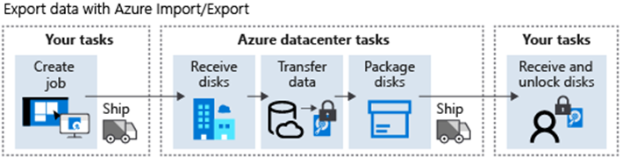
Import and Export Service (2 of 2)
Import jobs:
Export jobs:

Slide 48

AzCopy
AzCopy v10 features:
Supports Azure Data Lake Storage Gen2 APIs
Supports copying an entire account (Blob service only) to another account
Account to account copy is now using the new Put from URL APIs
List/Remove files and blobs in a given path
Supports wildcard patterns in a path
Improved resiliency
Authentication options:
Azure Active Directory
SAS tokens

Slide 49
Data Transfer Tool Selection
Dataset | Network Bandwidth | Solution to use
Large Dataset | Low-bandwidth network or direct connectivity to on-premises storage is limited by organization policies | Azure Import/Export for export; Data Box Disk or Data Box for import where supported; otherwise use Azure Import/Export
Large Dataset | High-bandwidth network: 1 gigabit per second (Gbps) - 100 Gbps | AZCopy for online transfers; or to import data, Azure Stack Edge, or Azure Data Box Gateway
Large Dataset | Moderate-bandwidth network: 100 megabits per second (Mbps) - 1 Gbps | Azure Import/Export for export or Azure Stack Edge for import where supported
Small Dataset: a few GBs to a few TBs | Low to moderate-bandwidth network: up to 1 Gbps | If transferring only a few files, use Azure Storage Explorer, Azure portal, AZCopy, or AZ CLI
Notes:
Instructor note: Reference https://azure.microsoft.com/en-us/services/databox/

Slide 50
Demonstration: AzCopy
Install AzCopy
Explore the help options
Download a blob from Azure Storage
Upload files to Azure blob storage

Slide 51
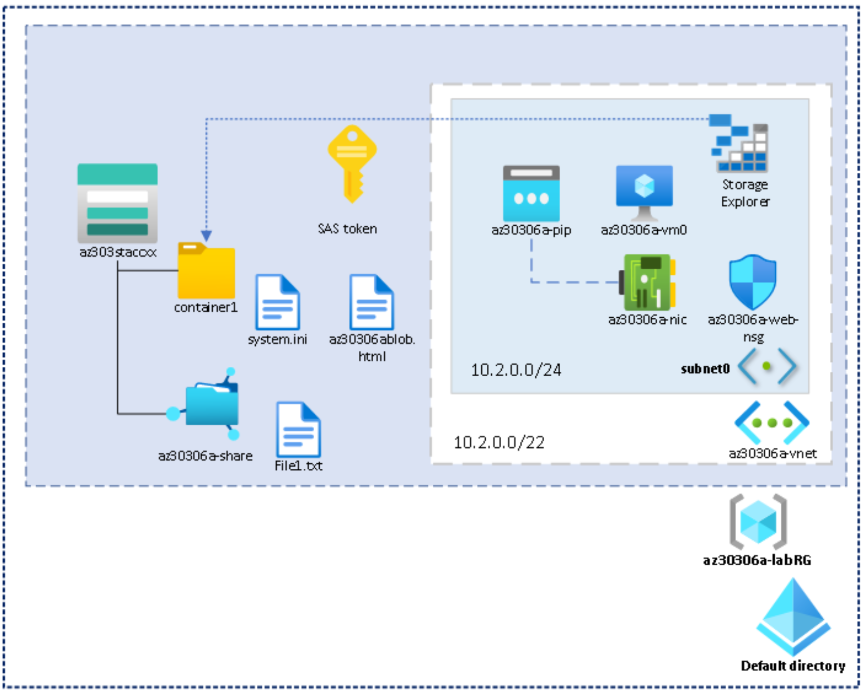
Lab: Implementing and configuring Azure Storage File and Blob Services

Slide 52

Module Review Questions

Slide 53
Online Role-based training resources: Microsoft Learn https://docs.microsoft.com/en-us/learn/

Slide 54
Thank you.

